Slide 1
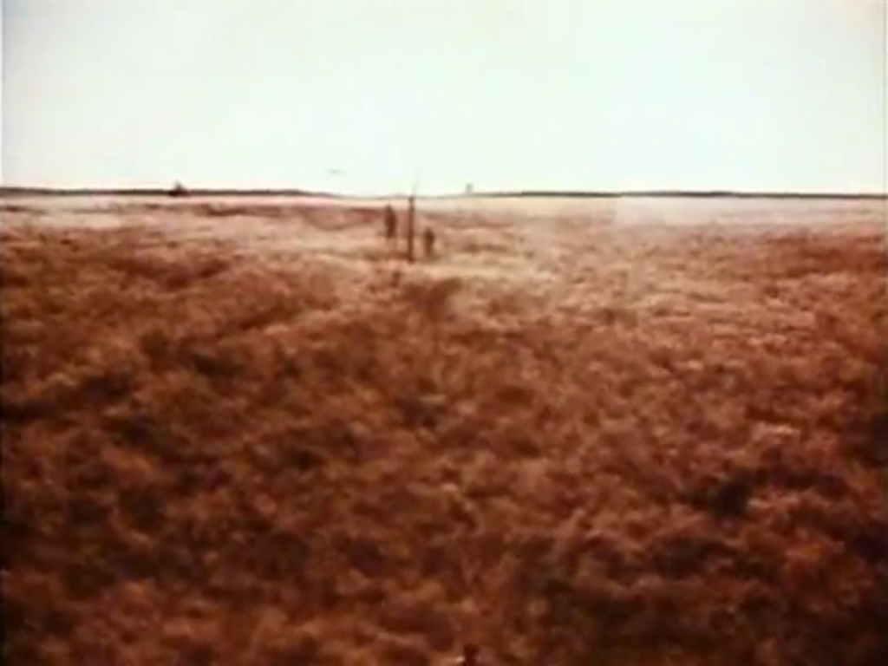
Our Sonic Environment
A Music & Sound Exhibit for
The Museum for Art and the Environment
Museum Studies Exhibit Final Project
Sean Murphy

Slide 3
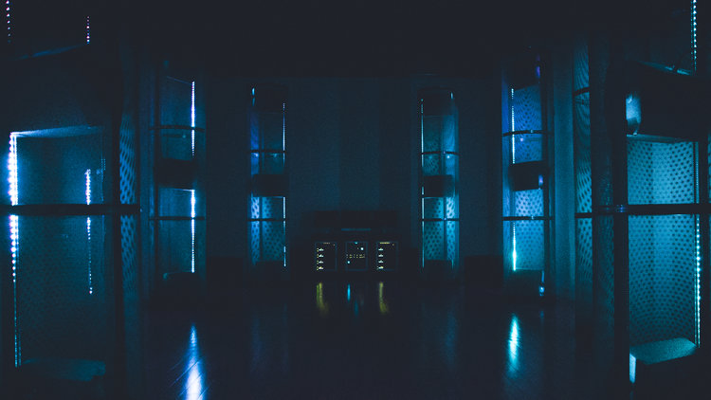
Listening Room
Features the Envelop sound system: 32 speakers surround the audience creating a sphere of spatial sound. Lighting design, projection art, scent and weather effects such as mist, rain, haze, heat, and wind will make for an immersive and multisensory experience.

Slide 4
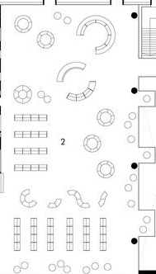
Installation Room
Sample layout.

Slide 5
Check List
Exhibit 1: John Luther Adams, Become Ocean
Exhibit 2: Tarek Atoui, Within
Exhibit 3: Andrew Bird, Echolocations: Canyon
Exhibit 4: Gavin Bryars, The Sinking of the Titanic
Exhibit 5: Brian Eno, Ambient 1: Music for Airports
Exhibit 6: Guillermo Galindo, Along the Border
Exhibit 7: Emeka Ogboh, Market Symphony
Exhibit 8: Pauline Oliveros, Deep Listening Room
Exhibit 9: Laurie Spiegel, The Expanding Universe
Exhibit 10: Chris Watson, Dawn Chorus
Exhibit 11: Chen Zhen, Jue Chang: Fifty Strokes to Each
* Right Click to open links.

Slide 6
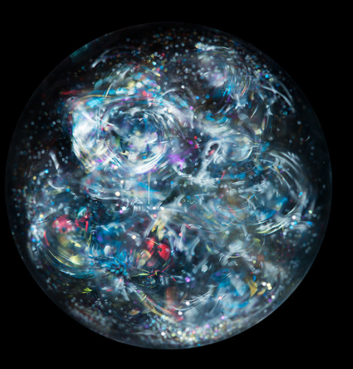
“Only a true appreciation of the acoustic environment can give us the resources for improving the orchestration of the world soundscape.” - R. Murray Schafer, The Tuning of the World

Slide 7
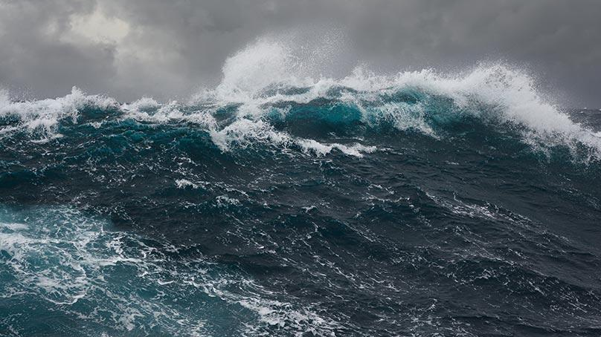
Exhibit 1 – John Luther Adams Become Ocean
Cantaloupe Music, 2014.
Presented in the Listening Room accompanied with projection art.
“Awarded the 2014 Pulitzer Prize for Music and described by the New Yorker’s Alex Ross as “...the loveliest apocalypse in musical history,” John Luther Adams’ majestic orchestral work Become Ocean is a thrilling exploration of depth, turbulence, eerie silence and ultimately enveloping calm. Performed by the Seattle Symphony under the baton of Ludovic Morlot, the music casts an expressive arc that’s by turns intimate and expansive -- an ebbing and flowing sonic journey that finds the composer testing the very limits of his imagination.” – NPR/Alex Ross
Link to the piece:
https://www.youtube.com/watch?v=dGva1NVWRXk (Courtesy of NAXOS of America)

Slide 8
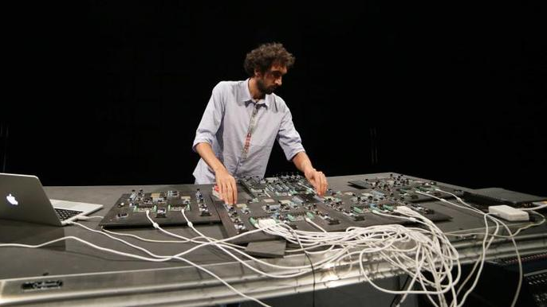
Exhibit 2: Tarek Atoui Within
13-17 Mar 2013, Sharjah Biennial 11, United Arab Emirates.
Interactive Installation
“Sound artist Tarek Atoui has researched the relationships between sound, vibrations, instruments and the body, starting with how the deaf perceive sound to develop tools and techniques for performing sound to a hearing-impaired audience. He challenges, expands and revises our established and conventional ways of experiencing sound. He has continued to research principals of sonic architecture in the development of instrument-building techniques. Several instruments that Atoui has been developing concurrently will be available to play. The audience will be encouraged to explore the acoustic relationships between individual instruments and the architecture that they inhabit.” – EMPAC, Troy NY
Short Video of Within from the 2016 Bergen Assembly in Bergen, Germany:
https://vimeo.com/192948836

Slide 9
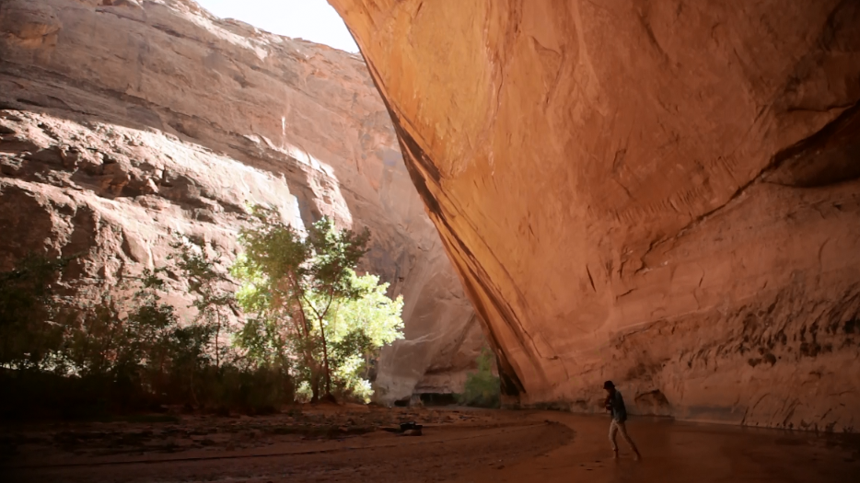
Exhibit 3: Andrew Bird Echolocations / Canyon
Presented in the Listening Room
“Recorded in the Coyote Gulch canyons of Utah, Echolocations / Canyon takes its musical inspiration from landscapes and environments with distinctive acoustics. Listen closely, and you can hear the echo of the violin on the stone canyon wall, and what sounds like a stream of water on the ground in this ambient composition. “ – ICA Boston
“The reflections off the landscape are triggering countless inferences and steering the conversation.” –Andrew Bird
A short documentary:
https://vimeo.com/121020464

Slide 10
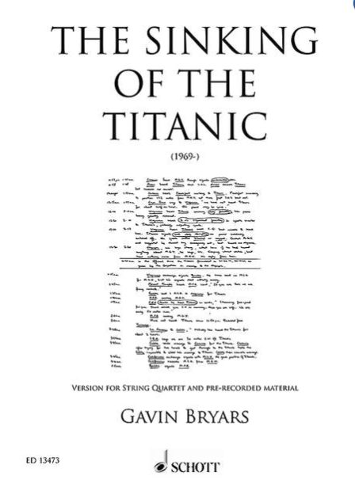
Exhibit 4: Gavin Bryars, The Sinking of the Titanic.
Obscure Records, 1975.
Presented in the Listening Room accompanied with projection art.
“Inspired by the story that the band on the RMS Titanic continued to perform as the ship sank in 1912. The initial starting point was the reported fact of the band playing the hymn tune ‘Autumn’ in the final moments of the ship’s sinking, together with other features of the disaster which generate musical or sounding performance material or which ‘take the mind to other regions’. Superimposed on the hymn tune, includes fragments of interviews with survivors, Morse sequences, musical references to different possible tunes for the hymn, the sound of the iceberg’s impact, and so on. Bryars said "the music goes through a number of different states, reflecting an implied slow descent to the ocean bed which give a range of echo and deflection phenomena, allied to considerable high frequency reduction". It recreates how the music performed by the band would reverberate through the water some time after they ceased performing.”
– Virginia Anderson
Link to the Wordless Music Orchestra’s Live Performance:
https://www.npr.org/2008/03/31/89127096/gavin-bryars-sinking-of-the-titanic-in-concert

Slide 11
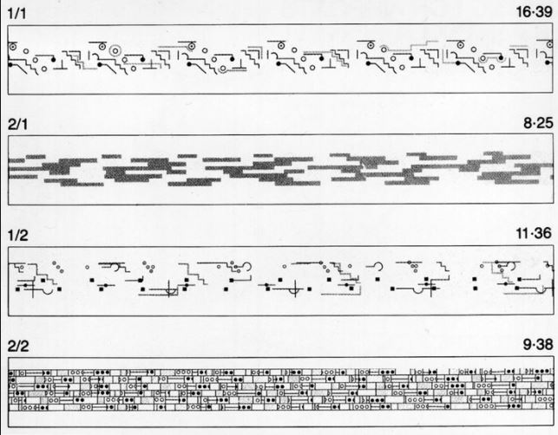
Exhibit 5:Brian Eno Ambient 1: Music for Airports
1980, Marine Terminal of New York at LaGuardia Airport.
Presented in the Listening Room accompanied with projection art.
“Rather than brightening and regularizing the atmosphere of an environment as typical background music does, Music for Airports is "intended to induce calm and a space to think." Eno conceived of the idea for Ambient 1 while spending several hours waiting at Cologne Bonn Airport in Germany in the mid-1970s and being annoyed by the uninspired sound atmosphere. The music was designed to be continuously looped as a sound installation, with the intent of defusing the tense, anxious atmosphere of an airport terminal by avoiding the derivative and familiar elements of typical "canned music". To achieve this, Eno sought to create music that would "accommodate many levels of listening attention without enforcing one in particular; it must be as ignorable as it is interesting.” – Christopher Scoates Brian Eno: Visual Music
Link to 1/1:
https://www.youtube.com/watch?v=NG19bapbnUU (Courtesy of Universal Music Group)

Slide 12
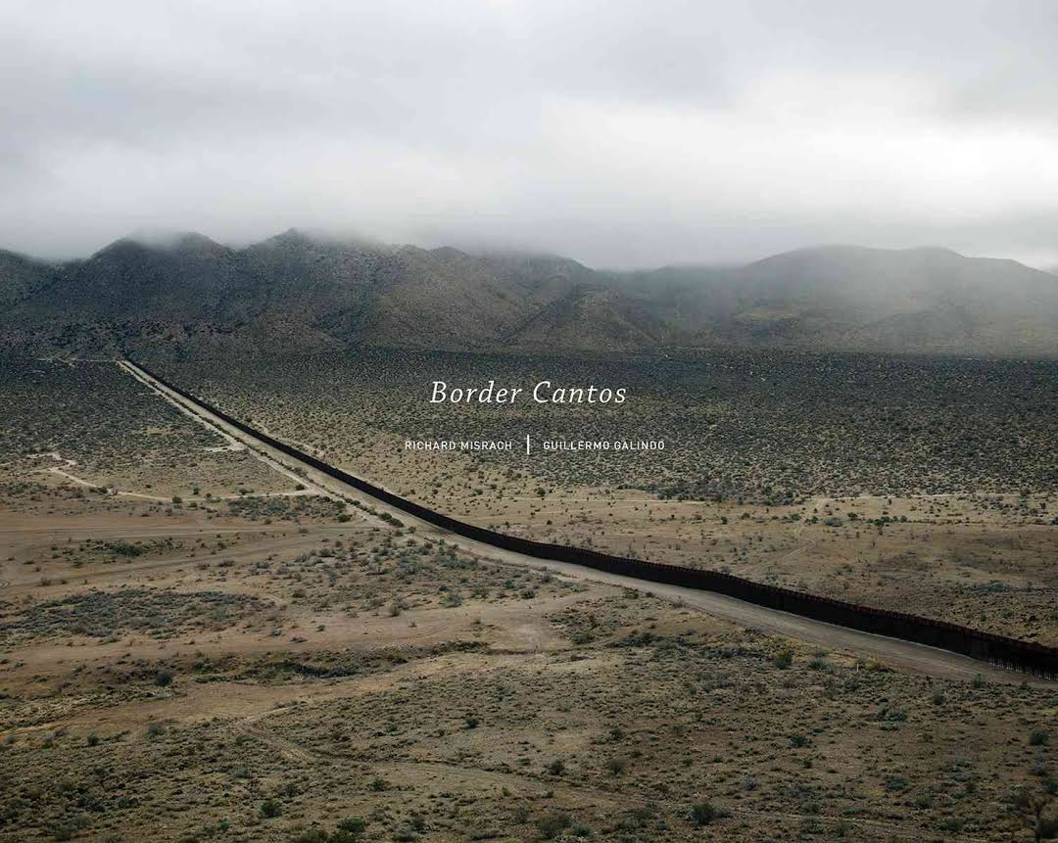
Exhibit 6: Guillermo Galindo, Along the Border
17 Feb – 22 Apr 2018 The Tang, Saratoga Springs, NY
Presented in the Installation Room
“Mexican artist Guillermo Galindo explores the economic, political, and social issues around the Mexico-United States border. Since 2009, Galindo has created a series of instruments, or as Galindo calls them, “cybertotemic sonic objects,” that are crafted from discarded objects found at multiple sites along the 2000-mile national divide. On exhibit are works constructed from discarded cans, shoes, bicycle wheels, wood, leather, and more.” – The Tang
More information on the Artist:
http://www.documenta14.de/en/artists/13506/guillermo-galindo

Slide 13
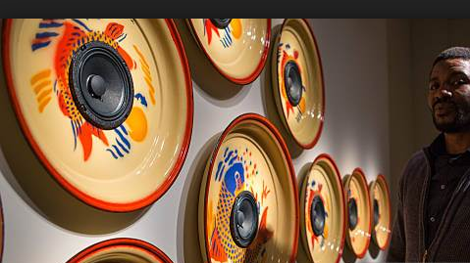
Exhibit 7: Emeka Ogboh, Market Symphony.
3 Feb 2016-26 Mar. 2017, Smithsonian Museum of African Art. Washington D.C.
Presented in the Listening Room
“Ogboh is interested in prompting a split- second sensation of dislocation, transporting the listener thousands of miles in an instant. The installation is visually simple, with enamelware trays adorned with fish, flowers, fruit, and 28 speakers lining the walls. Depending on where you stand, the rhythmic yelling of a hawker rises above the horns and shuffle of feet, or quieter discussions between shoppers emerge from the whoosh of buses or metallic noises of traders’ bells. Ogboh sampled hours of sounds from the Lagos markets, mostly in the large Balogun market that crosses numerous streets in the city with a lively flow of vendors selling cloth, food, produce, and other wares.” –We Face Forward
Link to the Exhibition: https://africa.si.edu/exhibitions/past-exhibitions/market-symphony-by-emeka-ogboh/

Slide 14
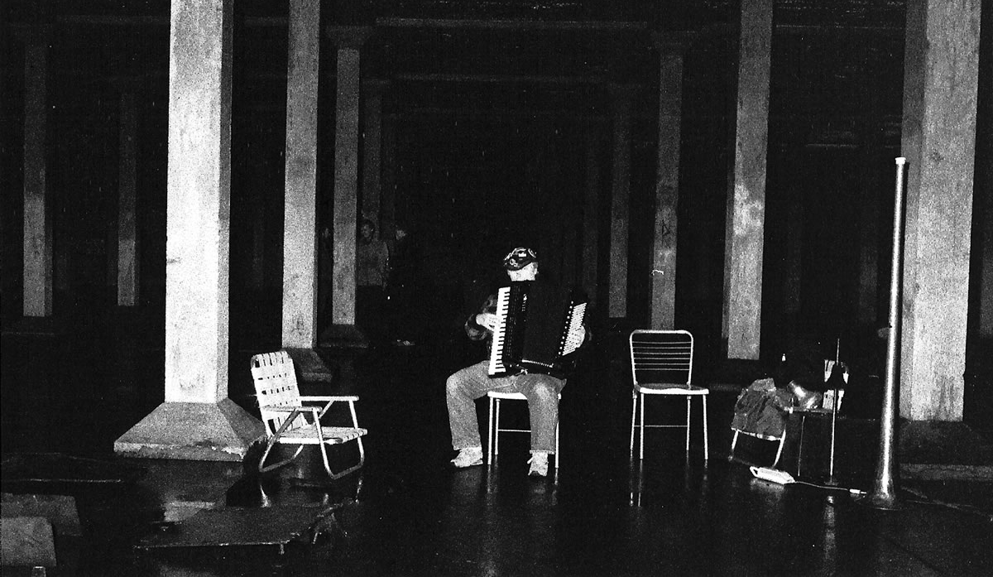
Exhibit 8: Pauline Oliveros, Deep Listening Room
21 May- 24 May 2014, Whitney Museum of American Art. New York, NY.
Link to Lear: https://www.youtube.com/watch?v=EskkbBbmDKE (Courtesy of The Orchard Enterprises)
“I am interested in music expanding consciousness. By expanding consciousness, I mean that old patterns can be replaced with new ones.” -Pauline Oliveros
“The room will feature Oliveros's Expanded Instrument System - a processing program that will hear the sounds of the lobby and transform them to sound art played in an eight-channel sound system. Compositions from Tape and Electronic Music 1961-1970 will also be featured along with slides and video projections on the walls of the gallery.” –The Whitney

Slide 15
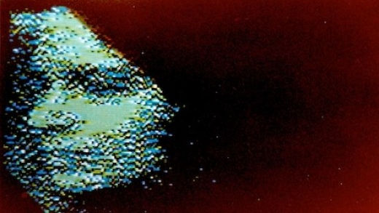
Exhibit 9: Laurie Spiegel The Expanding Universe.
Unseen Worlds, 1977.
Presented in the Listening Room accompanied with projection art.
“The Expanding Universe is nearly a half-hour of swelling, evolving tones, and she stresses that the composition is neither "minimalist" nor "ambient," and that it exists wholly in its own space. When modular synthesist, Laurie Spiegel contemplates orbits, heavenly bodies, and the cosmos through sound, her imagination is unparalleled. Album cut Kepler’s Harmony of the Worlds is one of the tracks on the Golden Record included onboard the Voyager I space mission.”
– Andy Beta, Pitchfork
Link to the piece:
https://www.youtube.com/watch?v=IKfLPXItwAM ( Courtesy of BWSCD, Inc.)

Slide 16
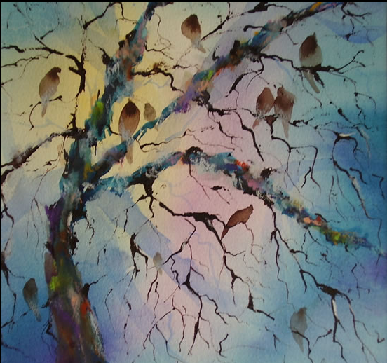
Exhibit 10: Chris Watson, Dawn
Chorus
25 Sep 2014 — 01 Jul 2018, Foundling Museum London, UK.
Presented in the Listening Room accompanied with projection art.
“In advance of the daylight sweeps a silver tide of birdsong, the dawn chorus.
I’ve had the privilege of recording birdsong around the world and consider that in our latitudes, between 50 to 58 degrees North, we have the best dawn chorus in the world.
Migrant birds from sub Saharan Africa fly to Northern Europe and between April to June their songs and signals mix and merge with native British birds to create a complex ensemble of voices. This daily chorus is a focused and intense period of around 90 minutes before sunrise illuminates the landscape and the birds’ attentions turns to nest building, feeding and family life.
I’ve long been fascinated by the dawn chorus in Britain and in particular the idea of this wave of song that illuminates a path cross country through a wide variety of habitats.”
- Veteran BBC nature sound recordist Chris Watson
Link from the BBC: https://www.bbc.co.uk/programmes/b05n1hws

Slide 17
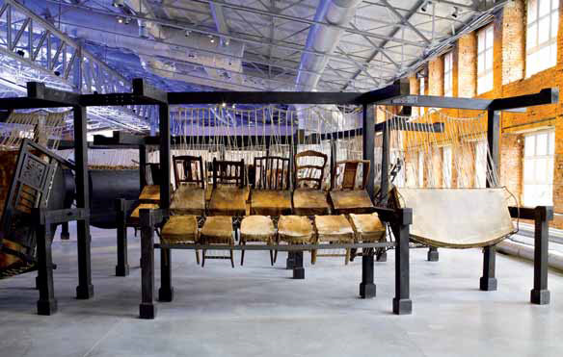
Exhibit 11: Chen Zhen, Jue Chang: Fifty Strokes to Each
13 Jun – 17 Nov 1999, Venice Biennale
Interactive Installation
“Jue Chang deals metaphorically with conflicts and misunderstandings among people, in the immediate context of the Middle East, but also in a more general, global context. It is inspired by the Chinese Chan-Buddhist tradition; according to the Chan, "Bang He" (giving a lesson with a stick) means that the person who chooses to pray to the Buddha, or talk about its spirituality, should be beaten, to be reminded that the "Buddhist Heart" is everywhere. Also in the Chan tradition, striking both parties involved in a dispute ("fifty strokes to each" as the Buddhist maxim recommends) is considered an effective way for settling conflicts. Visitors are invited to play an active role and drum on this "instrument".” - Adrian Searle

Slide 18
Resources:
Slide from Page 3: “Envelop.” Envelop, www.envelop.us/.
Slide from Page 4: Floorplan of the Second Floor of the Bishan Library, Singapore.
Schafer, R. Murray. The Tuning of the World. 1977. Knopf. New York, NY 11. Print
Exhibit 1: Ross, Alex. “Water Music: John Luther Adams’s “Become Ocean” The New Yorker, 8 Jul 2013, https://www.newyorker.com/magazine/2013/07/08/water-music-3, Accessed 14 Apr 2018.
Exhibit 2: “Within Tarek Atoui.” EMPAC, 13 May 2016, http://empac.rpi.edu/events/2016/spring/within/
Exhibit 3: Andrew Bird. Echolocations:Canyon. Wegawam Music Co. 2015.
Exhibit 4: Anderson, Virginia. Whatever Remains, However Improbable: British Experimental Music and Experimental Systems: Future Knowledge in Artistic Research. Ed. Michael Schwab. Leuven University Press, 2013. 61. Print
Exhibit 5: Scoates, Christopher. Brian Eno: Visual Music. 2013. Chronicle Books. San Francisco, CA. 117. Print
Exhibit 6: “Along the Border” Tang, 17 Feb 2018, https://tang.skidmore.edu/exhibitions/245-along-the-border
Exhibit 7:“Music from West Africa Today” WeFaceForward, 2 June 2012, http://www.wefaceforward.org/artists/emeka-ogboh
Exhibit 8: “Pauline Oliveros” Whitney, 21 May 2014, https://whitney.org/Events/PaulineOliveros
Exhibit 9: Beta, Andy. “Laurie Spiegel: The Expanding Universe” Pitchfork, 24 Oct 2012, https://pitchfork.com/reviews/albums/17067-the-expanding-universe Accessed 13 Apr 2018.
Exhibit 10: “Heralds of the Dawn – Chris Watson on the dawn chorus” Bowers & Wilkins 1 May 2016, http://blog.bowers-wilkins.com/speakers/hi-fi-speakers-hi-fi/heralds-of-the-dawn-chris-watson-on-the-dawn-chorus/ Accessed 19 Apr 2018.
Exhibit 11: Searle, Adrian. “Please Do Not Sit on the Artwork.” The Guardian, 1 May 2001, https://www.theguardian.com/arts/critic/feature/0,1169,728601,00.html, Accessed 12 Apr 2018.

